Slide 1


Understanding 6G Technology
6G promises speeds 100x faster than 5G, delivering terabit-per-second data rates with ultra-low latency under 1 millisecond. This transformative leap will power AI-native networks that fundamentally reshape how we connect.
Game-Changing Applications
Fully autonomous vehicles with instant response
Immersive holographic communications
Smart cities with real-time intelligence
Massive IoT ecosystems connecting trillions of devices
University Institute of Technology - RGPV, Bhopal
Department of Information Technology
GD Seminar Presentation
Topic: Cybersecurity in 6G Networks
Submitted By:
Yogiraj Patidar (0101IT231080)
Deepak Sahu (0101IT231081)
Adnan Khan (0101IT243D01)
Bhavna (0101IT243D03)
Submitted to:
Prof. Shifa Manihar
Dept. of Information Technology

Slide 2

Why Cybersecurity Matters More Than Ever
Understanding 6G Technology
6G promises speeds 100x faster than 5G, delivering terabit-per-second data rates with ultra-low latency under 1 millisecond. This transformative leap will power AI-native networks that fundamentally reshape how we connect.
Game-Changing Applications
Fully autonomous vehicles with instant response
Immersive holographic communications
Smart cities with real-time intelligence
Massive IoT ecosystems connecting trillions of devices

Slide 3
Why Cybersecurity Matters More Than Ever in 6G

Slide 4

Why Cybersecurity Matters More Than Ever
Massive Scale
6G will connect billions more devices than ever before, creating an exponentially larger attack surface for potential threats.

Slide 5

Why Cybersecurity Matters More Than Ever
Massive Scale
Sophisticated Attacks
6G will connect billions more devices than ever before, creating an exponentially larger attack surface for potential threats.
As networks evolve, cybercriminals develop more advanced techniques to exploit vulnerabilities and breach systems.

Slide 6

Massive Scale
Sophisticated Attacks
Data Protection
6G will connect billions more devices than ever before, creating an exponentially larger attack surface for potential threats.
As networks evolve, cybercriminals develop more advanced techniques to exploit vulnerabilities and breach systems.
With more sensitive personal and business data flowing through networks, protecting privacy becomes increasingly complex and critical.

Slide 7




Common Cyber Threats in 6G Networks
Data Theft
Unauthorized access to steal valuable personal or corporate
information from network systems.
Identity Theft
Criminals impersonating users to gain access to accounts,
services, and sensitive resources.
System Hacking
Breaking into networks and devices to control systems or
extract confidential data.
DDoS Attacks
Overwhelming networks with traffic to shut down services
and disrupt operations.
Malware & Viruses
Malicious software designed to damage systems, steal data,
or create backdoors for attackers.
Critical Security Challenges Ahead
Expanded Attack Surface
More connected devices mean exponentially more entry points for hackers to exploit and compromise
network security.
Data Privacy Concerns
Protecting sensitive personal information becomes harder as data flows across more platforms and
devices simultaneously.
Device Authentication
Identifying and preventing fake or cloned devices from accessing the network poses a growing challenge.
AI-Powered Threats
Cybercriminals leveraging artificial intelligence to create more sophisticated, adaptive, and harder-to-
detect attacks.
IoT Vulnerabilities
Many Internet of Things devices lack robust security features, creating weak points throughout the
network.

Slide 8




Common Cyber Threats in 6G Networks
Advanced Security Technologies for 6G
Data Theft
Strong Encryption
Secure Authentication
Continuous Monitoring
Unauthorized access to steal valuable personal or corporate
information from network systems.
Advanced cryptographic methods that scramble data, making it unreadable to unauthorized users even if intercepted during transmission.
Multi-factor verification and biometric systems ensuring only authorized users and devices can access the network.
Real-time surveillance systems that track network activity 24/7 to detect and respond to threats instantly.
Identity Theft
Criminals impersonating users to gain access to accounts,
services, and sensitive resources.
System Hacking
Breaking into networks and devices to control systems or
extract confidential data.
AI Threat Detection
DDoS Attacks
Overwhelming networks with traffic to shut down services
and disrupt operations.
Machine learning algorithms that identify patterns, predict attacks, and automatically respond to emerging security threats.
Malware & Viruses
Malicious software designed to damage systems, steal data,
or create backdoors for attackers.

Slide 9

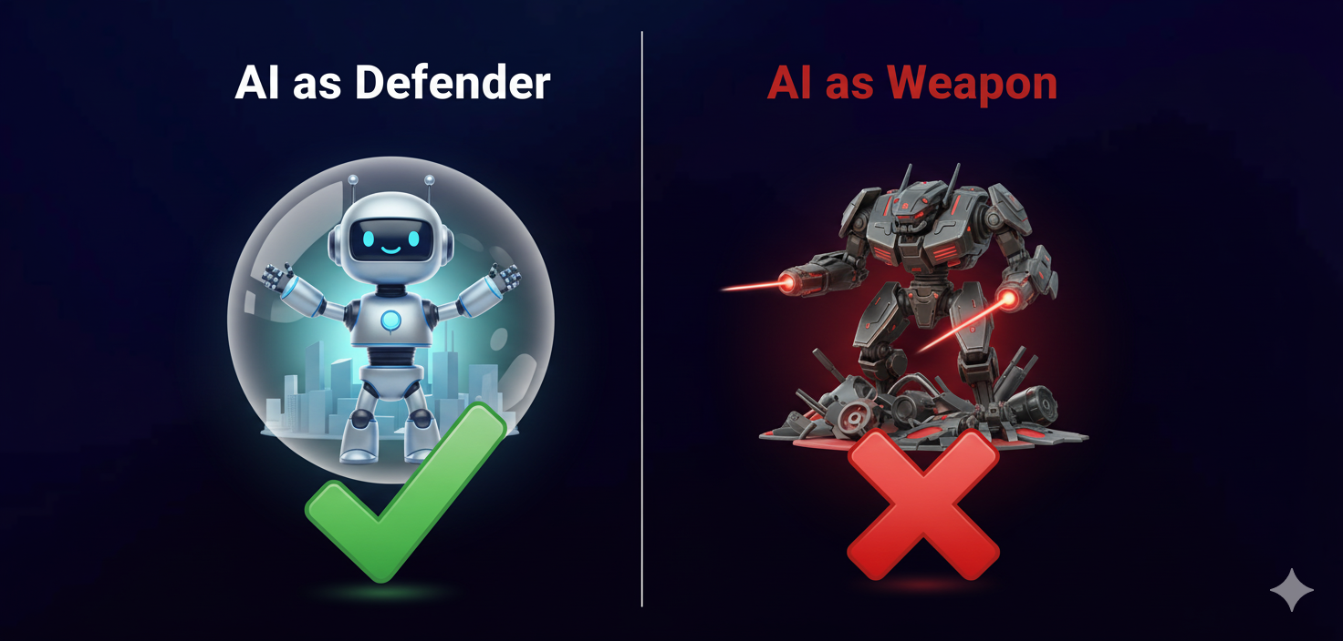
Advanced Security Technologies for 6G
Strong Encryption
Secure Authentication
Continuous Monitoring
Advanced cryptographic methods that scramble data, making it unreadable to unauthorized users even if intercepted during transmission.
Multi-factor verification and biometric systems ensuring only authorized users and devices can access the network.
Real-time surveillance systems that track network activity 24/7 to detect and respond to threats instantly.
AI Threat Detection
Machine learning algorithms that identify patterns, predict attacks, and automatically respond to emerging security threats.
The Dual Role of AI in 6G Security
✓ AI as a Defender
Artificial intelligence can detect cyber threats in real-time by analyzing massive amounts of network data. It identifies unusual patterns and predicts potential attacks before they happen, enabling proactive defense measures that keep systems secure.
⚠ AI as a Weapon
However, cybercriminals also leverage AI to create smarter, more adaptive attacks. AI-powered malware can learn and evolve to bypass security measures, making the cybersecurity landscape an ongoing arms race between defenders and attackers.

Slide 10

How Users Can Protect Themselves
01
02
Use Strong Passwords
Keep Devices Updated
Create unique, complex passwords with mixed characters and enable two-factor authentication wherever possible.
Regularly install software and security updates to patch vulnerabilities and protect against new threats.
The Dual Role of AI in 6G Security
✓ AI as a Defender
03
04
Artificial intelligence can detect cyber threats in real-time by analyzing massive amounts of network data. It identifies unusual patterns and predicts potential attacks before they happen, enabling proactive defense measures that keep systems secure.
Avoid Unknown Apps
Check Privacy Settings
Only download applications from trusted sources and review permissions before installation.
Review and adjust privacy controls on all devices and accounts to limit data sharing.
⚠ AI as a Weapon
05
However, cybercriminals also leverage AI to create smarter, more adaptive attacks. AI-powered malware can learn and evolve to bypass security measures, making the cybersecurity landscape an ongoing arms race between defenders and attackers.
Stay Alert Online
Never click suspicious links or open unexpected attachments that could
contain malware.

Slide 11
How Users Can Protect Themselves
01
02
Use Strong Passwords
Keep Devices Updated
Create unique, complex passwords with mixed characters and enable two-factor authentication wherever possible.
Regularly install software and security updates to patch vulnerabilities and protect against new threats.
03
04
Avoid Unknown Apps
Check Privacy Settings
Only download applications from trusted sources and review permissions before installation.
Review and adjust privacy controls on all devices and accounts to limit data sharing.
05
Stay Alert Online
Never click suspicious links or open unexpected attachments that could
contain malware.

Slide 12
Conclusion
Revolutionary Technology
Security is Essential
Protecting What Matters
6G will bring transformative capabilities that reshape how we communicate, work, and live in an interconnected world.
Strong cybersecurity measures are not optional—they're fundamental to realizing 6G's full potential safely.
Safe networks safeguard users, data, privacy, and the critical infrastructure our society depends on daily.
We must prepare today for the cyber threats of tomorrow. The future of 6G depends on our collective commitment to building secure, trustworthy networks that serve everyone safely.

Slide 13

Thankyou Everyone
For your attention

